Slide 1


Slide 2
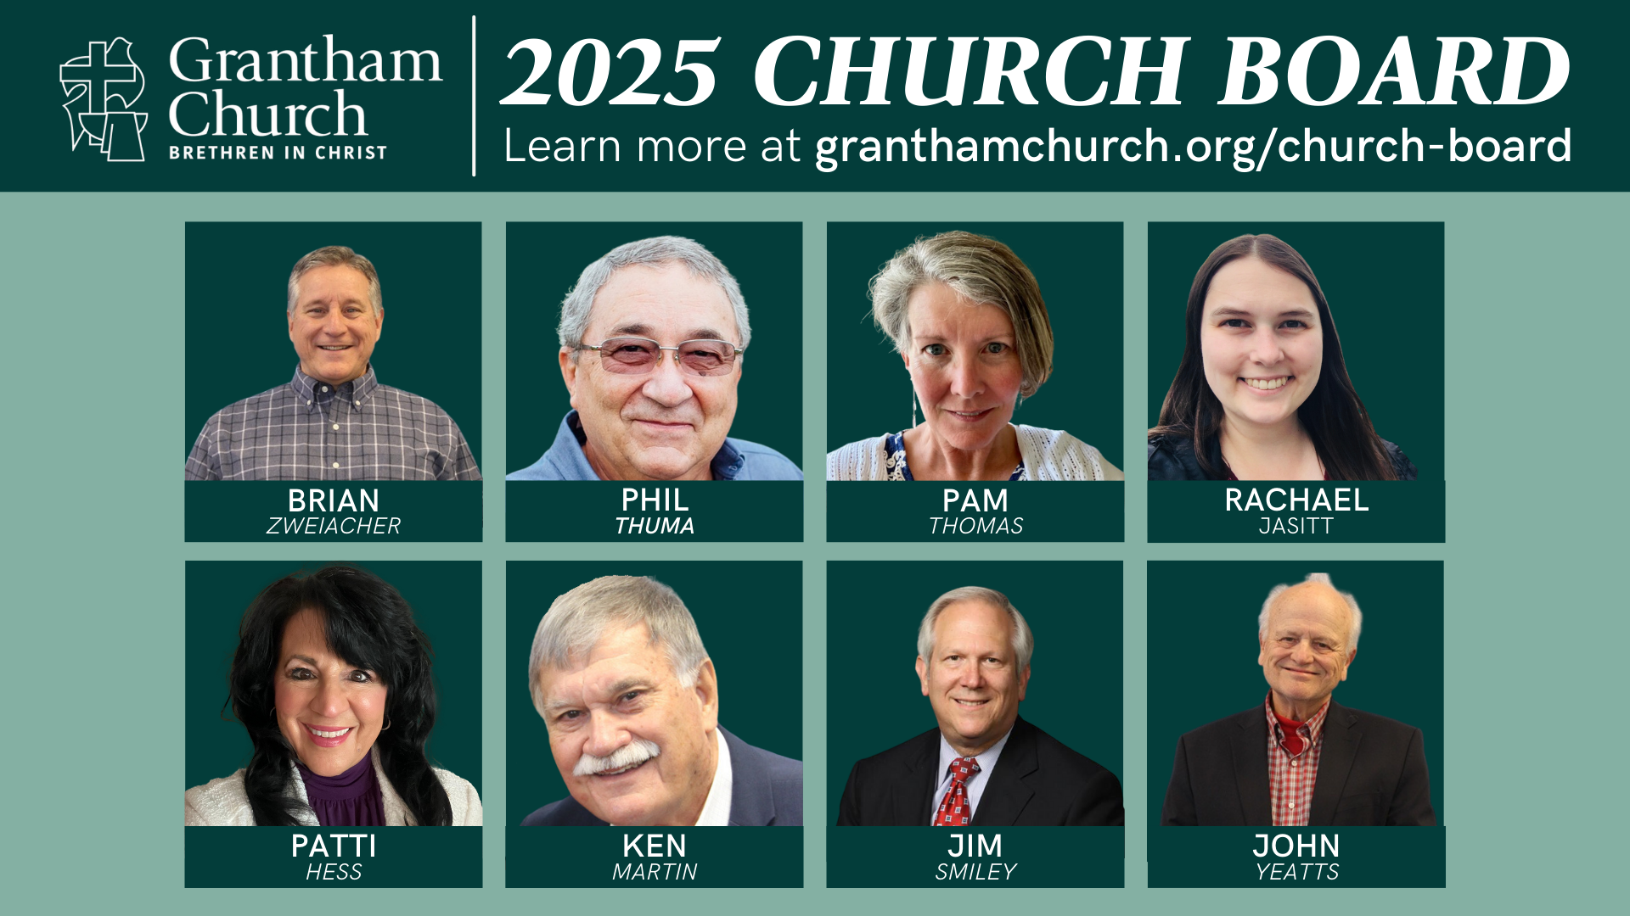

Slide 3


Slide 4


Slide 5


Slide 6


Slide 8


Slide 9
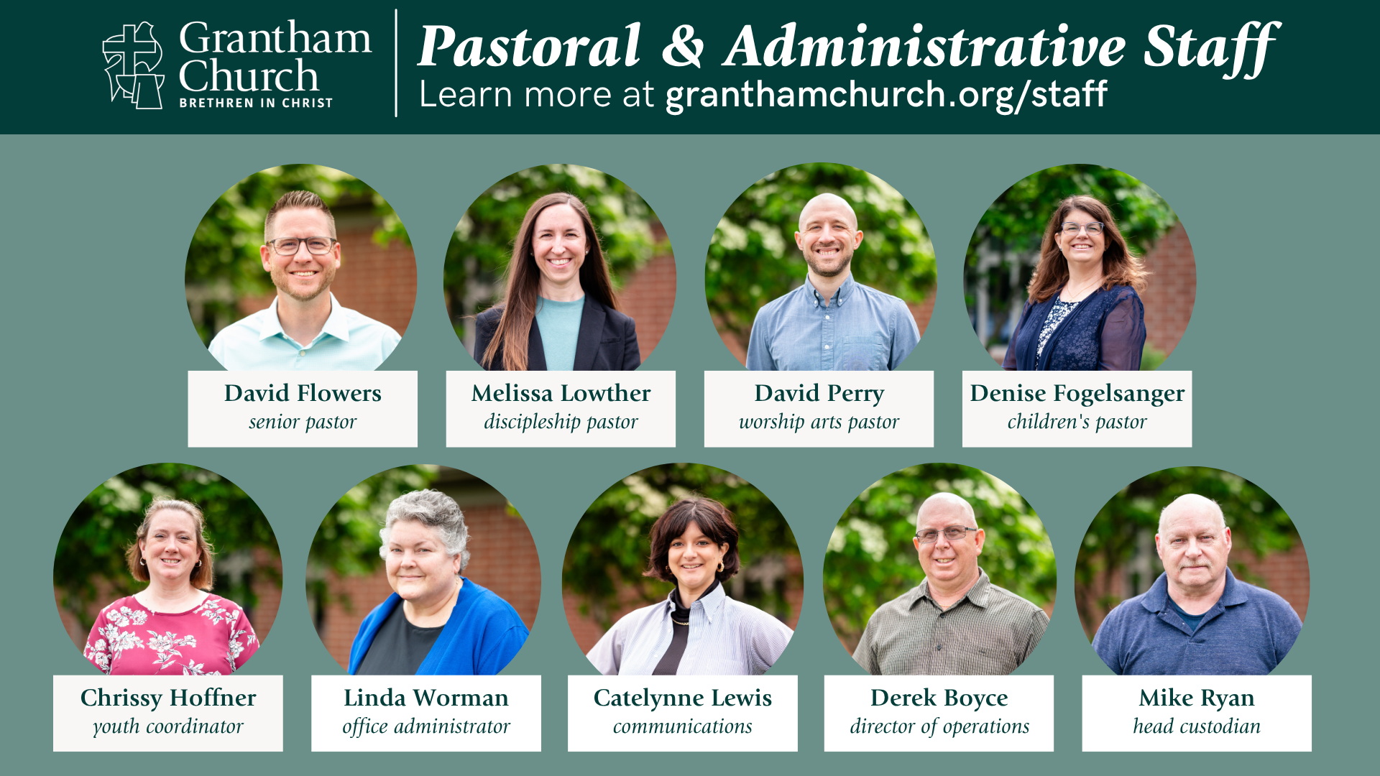

Slide 10
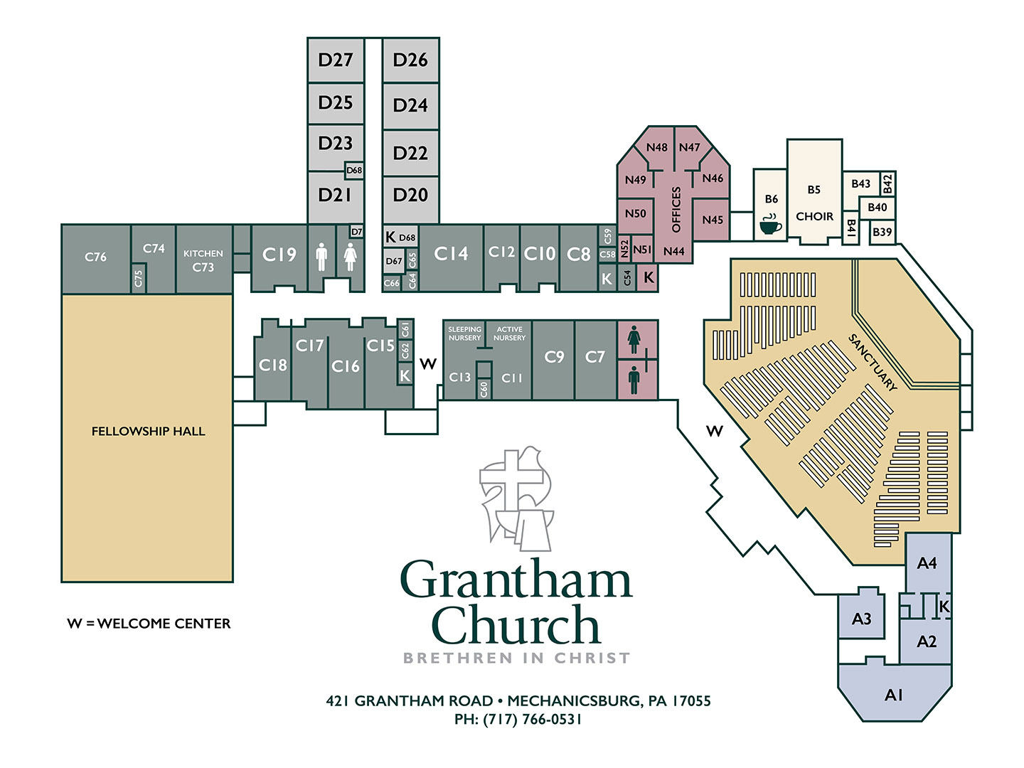

Slide 11


Slide 12
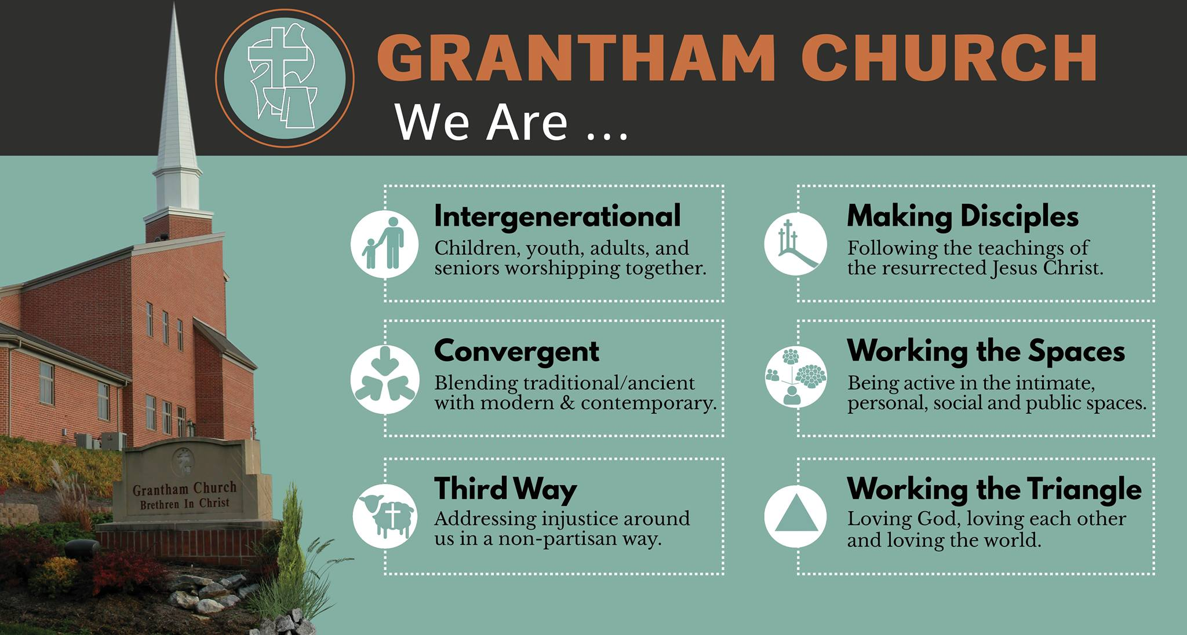

Slide 13
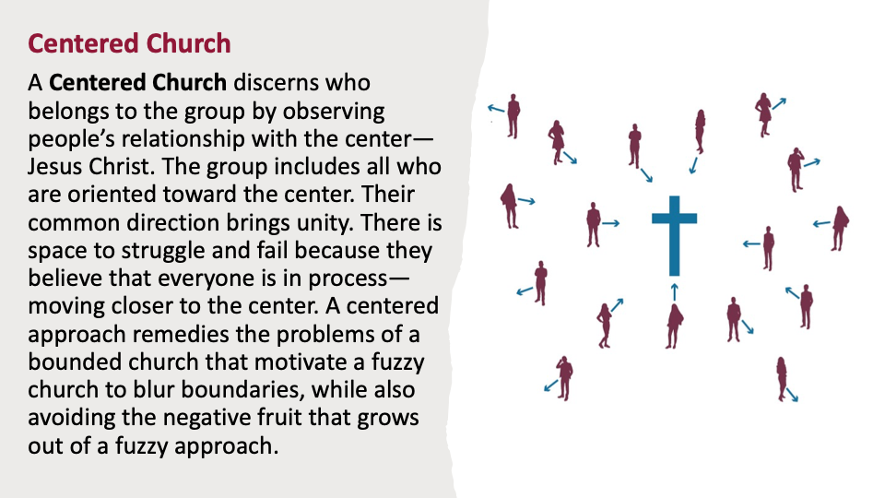

Slide 14


Slide 15


Slide 16
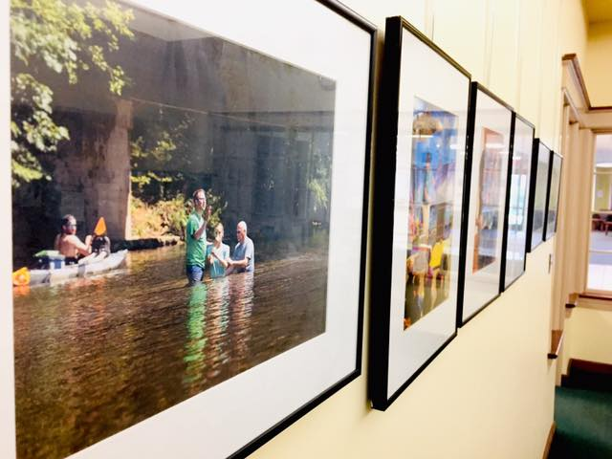

Behind the Scenes
Some stuff that leadership has worked on in 2025:
Filmed a new Welcome video and took staff pics for website
Upgrading our technology: PushPay, website, My Church app, AV, etc.
Increased stewardship of property and facilities on a weekly basis
Began the Thriving Congregations Initiative (BIC & Lily Foundation)
Messiah offered our pastors an afternoon workshop on AI usage
Our staff did a 3-hr Working Genius Workshop with Ruby Nolt (consultant)
Continued strengthening relationship with Messiah University and forming a working partnership with Interim President, Admin, and Campus Ministries
Pastors David and Melissa completed requirements for ordination –
special Ordination Service planned for Sun, Feb 15 @ 7:00 pm

Slide 17


Slide 18
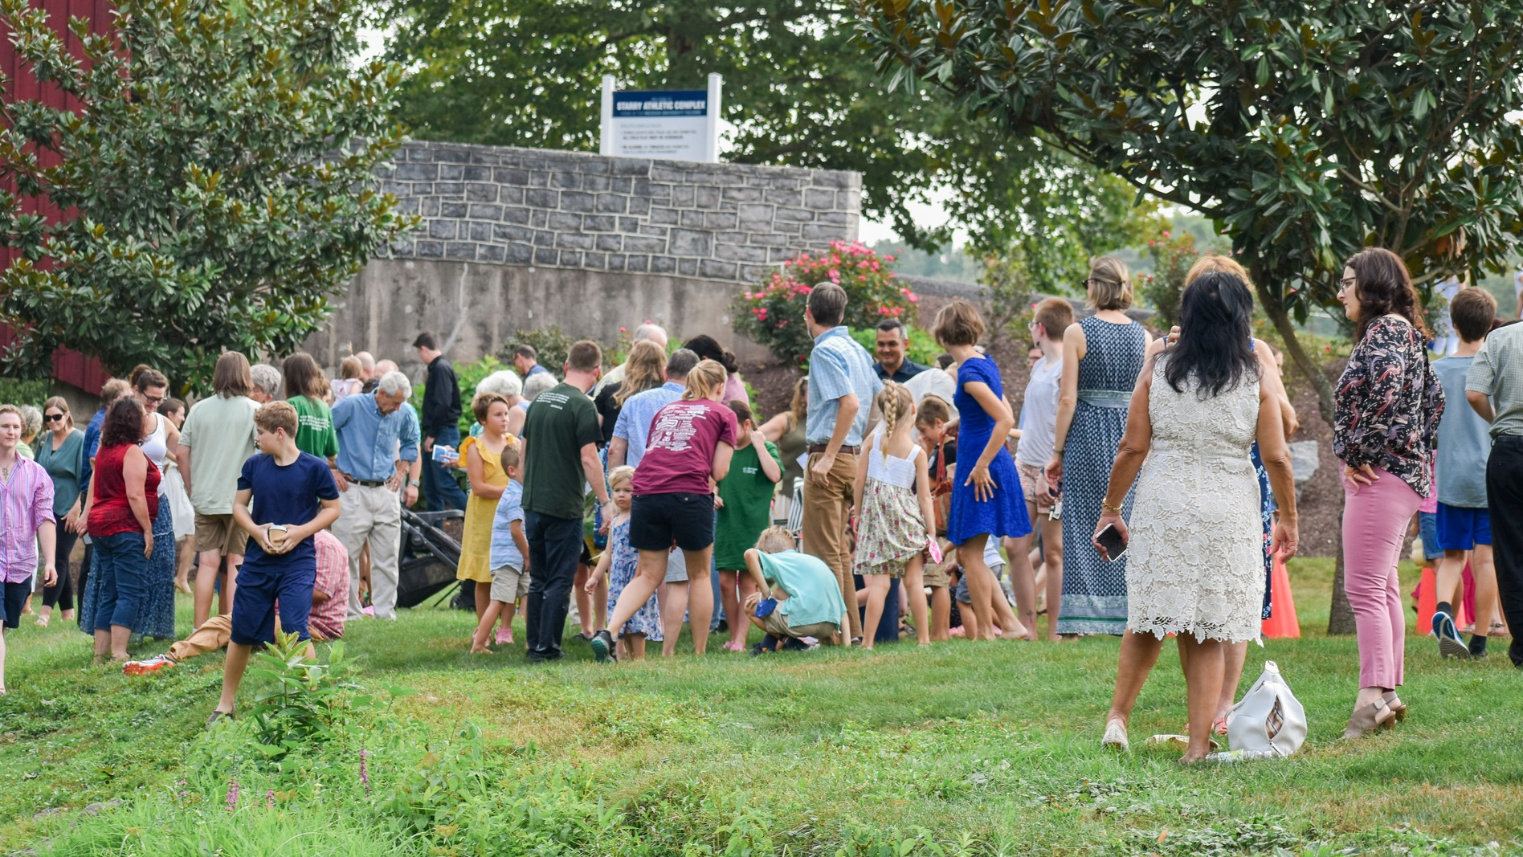
A Look Back at 2025
Avg. in-person attendance: 305 (up from 299 in 2024)
Avg. YouTube livestream views: 143 (up from 75 in 2024)
Highest Sunday of the year: 438 on Easter Sunday
Other important stats:
  2 child dedications
  15 baptisms (Easter, Summer & Fall)
  26 new members
  Total Membership: 350

Slide 19
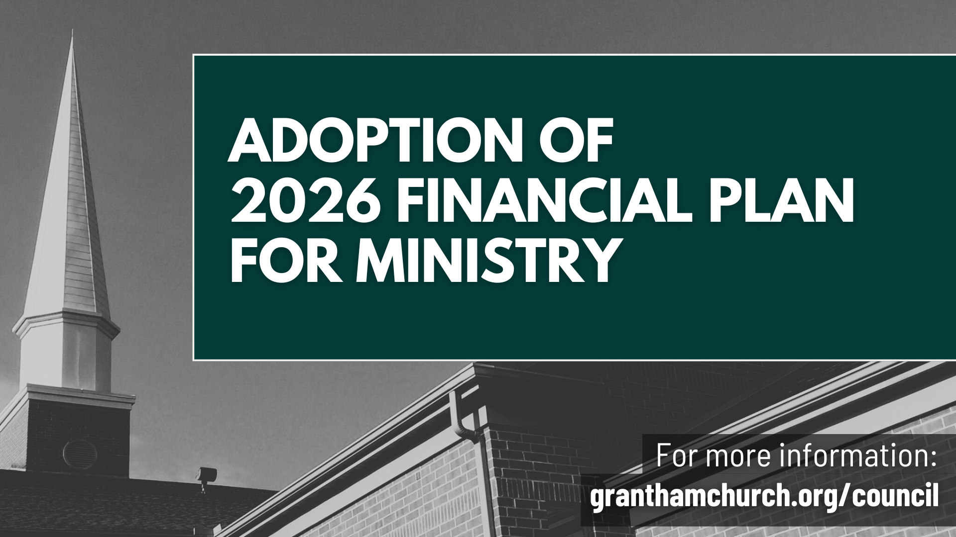

Slide 20


Slide 22
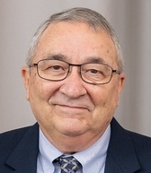
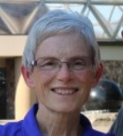
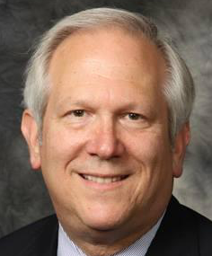
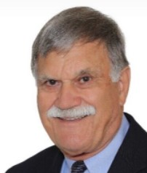
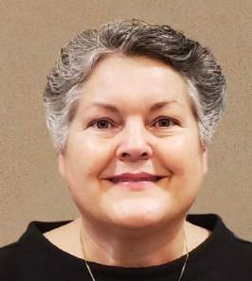
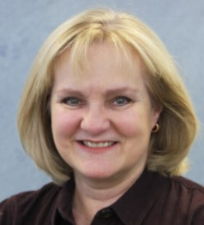
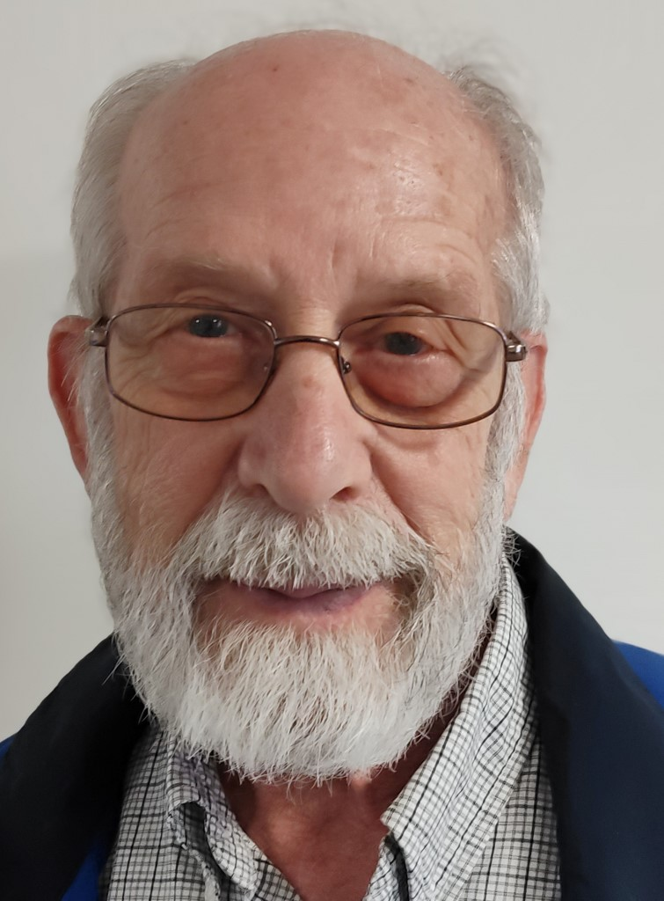
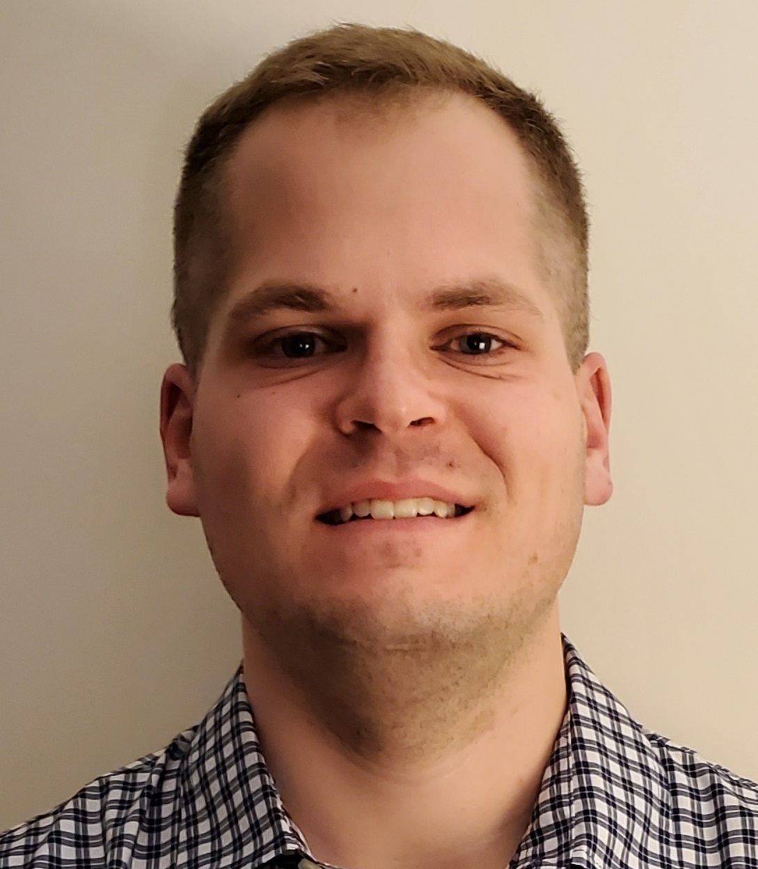
Phil Thuma, Treasurer
Lynn Brown, Assist Treas
Jim Smiley, Secretary
Ken Martin
Linda Worman, Staff Rep
Lisa Sechrist
Roger Johnson
Matthew Haar

Slide 23
HOW HAVE WE DONE FINANCIALLY IN 2025 ?
2025 Income/Expense Report
(year to date vs budget)

Slide 24
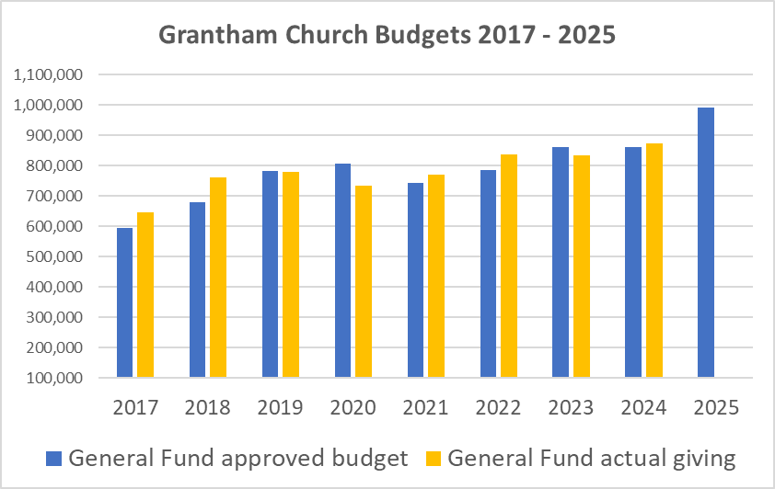

Slide 26


Slide 29


Slide 30
Income/Expense Report for 2025 to date
Summary
Undesignated (General Fund) total income has been more year to date than it was in 2023 and 2024
(currently contributions are 5.9% behind budget vs 7.6% behind budget in 2023)
Expenses have generally been close or a little lower than the approved budget
BIC Common fund continues to receive 10% of the Undesignated income

Slide 33
FUNDS SENT FROM GRANTHAM CHURCH TO OTHERS – 2025 (YTD)
Common Ministry (BIC Church) - $74,343
Ministry Partners - $50,710
BIC World Missions - $1,731
Grantham Missionaries - $7,500
Peace Sunday: BIC Historical / Global Sharing- $7,371
Missions Day: Ecuador (Medinas) - $7,070 to date
Over $ 148,000 year to date

Slide 34
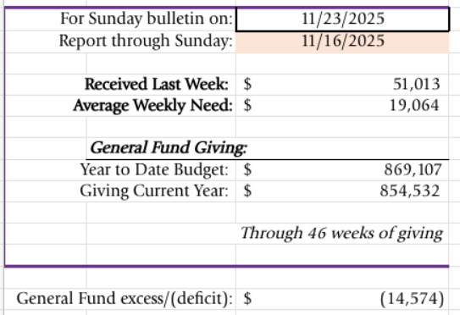

Slide 35
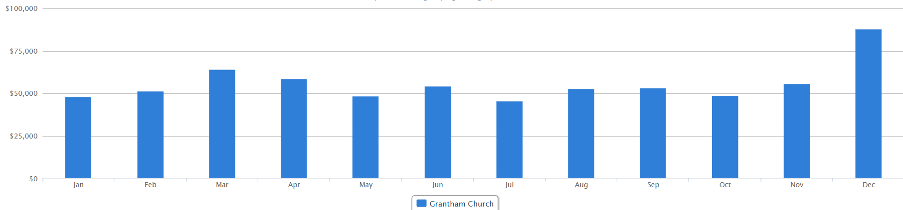
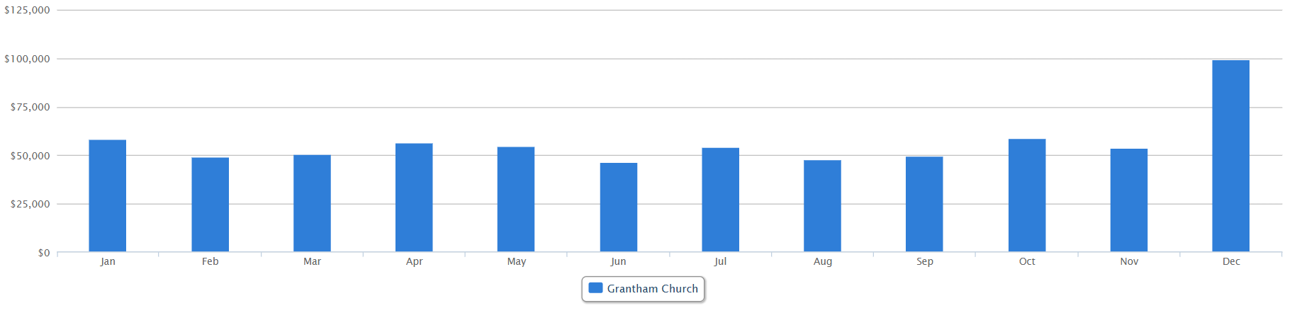
Giving to General Fund by Month - 2024
Giving to General Fund by Month - 2023

Slide 36
THANK YOU FOR YOUR GENEROUS GIVING

Slide 37
WHAT ARE WE PROPOSING FOR 2026 ?
2026 Financial Plan
for Ministry
(see pages 9 – 12 in booklet)

Slide 38
2026 Proposed Expenses

Slide 39

2026 Proposed Income

Slide 40
2026 Proposed Income

Slide 41
2026 Proposed Expenses

Slide 42
SUMMARY: WHAT ARE WE PROPOSING FOR 2026 ?
Increase in General Fund (undesignated) offerings of $434 above the 2025 budget
Funding in 2026 for any Capital Projects to come from special offerings/donations

Slide 43
Questions and Discussion
Email: gcfinance@granthamchurch.org

Slide 45
2025 Proposed Expenses

Slide 46
2025 Proposed Income
* Facility Use/Rental, Credit card use rebate

Slide 48
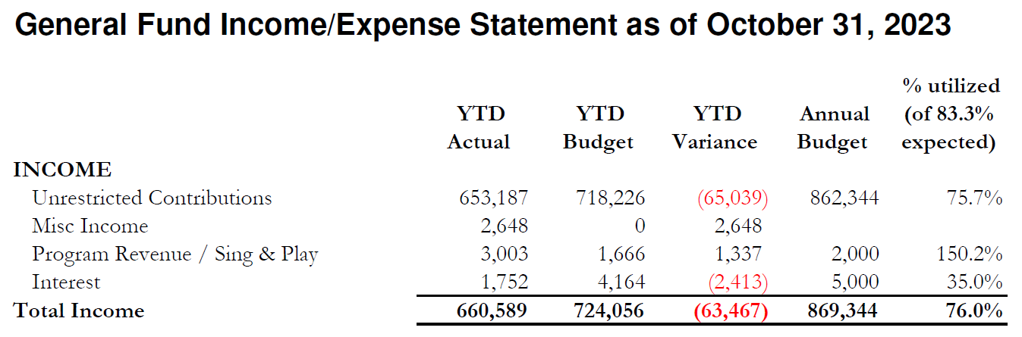

Slide 49


Slide 50


Slide 51


